Slide 1

Implementing Cross-Enterprise Document Sharing (XDS) based on Blockchain Technology
Petnathean Julled
Progress 2 Jan. 2020

Slide 2
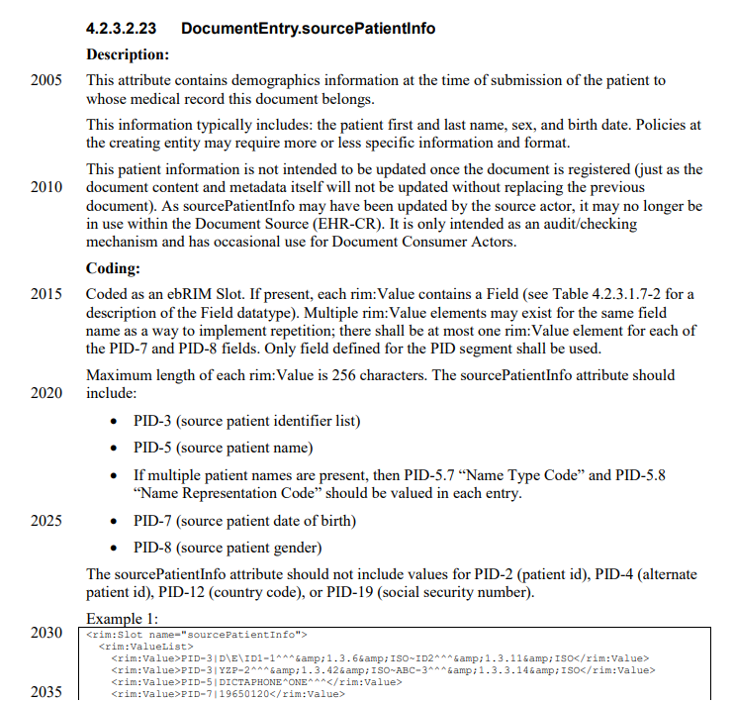
What META-Data Attribute that need confidentiality
DocumentEntry.sourcePatientInfo
  The attribute contain HL7 message that contain information of patient related to the document
  According to HIPAA, as this attribute contain personal information of the patient, it must be kept under confidentiality control (i.e. access control, encryption, or both)
    HIPAA also proposed concept of de-identification that reduce components of data-set to the point that it cannot be identifiable whose it belonged.

Slide 3
What META-Data Attribute that need confidentiality

Slide 4
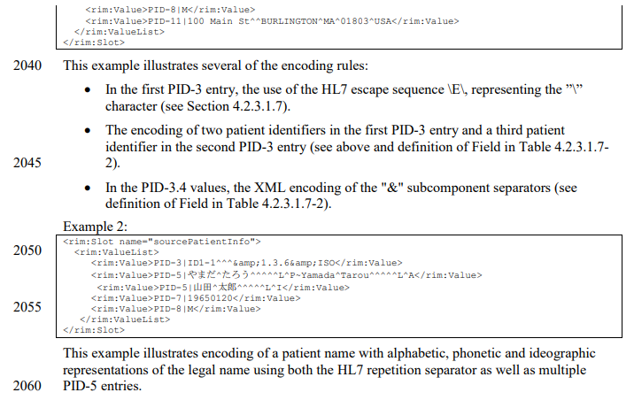
What META-Data Attribute that need confidentiality

Slide 5
XDS META-Data Attributes with Sensitive Information
For 1st stage, rely on permission system came along with Smartcontract
For 2nd stage, Encryption

Slide 6
For 1st stage, rely on permission system came along with Smartcontract
For 1st stage, rely on permission system came along with Smartcontract
  There are several Solidity Module that allow permission control on specific Ethereum Identity Address to access certain smartcontract.
  OpenZeppelin Module is one of stable module that can be used on our implementation.
  User Identity on Blockchain network will be assigned with “Ethereum Identity Address” and “Role”
    Ethereum Identity Address is unique identifier that identify each User Identity on Ethereum Blockchain Network.
    Role define accessibility to certain smartcontract which defined within its Solidity code.

Slide 7
For 2nd stage, Encryption
The vital point is key distribution and management amongst Blockchain nodes
Selection of encryption key management system can be varied upon organization environment, relationship, and policy between each organizations.
  Ref.1: https://www.helpnetsecurity.com/2019/11/07/encryption-key-management-system/
  Ref.2: https://nvlpubs.nist.gov/nistpubs/SpecialPublications/NIST.SP.800-130.pdf
  Ref3: https://en.wikipedia.org/wiki/Key_management#Management_and_compliance_systems
  Ref4: https://www.cryptomathic.com/hubfs/Documents/White_Papers/Cryptomathic_White_Paper_-_Selecting_The_Right_Key_Management_System.pdf
On our prototype, assume that all nodes have received key through secured method
(i.e. Physical interaction and negotiation)

Slide 8
Task List
Create Javascript program which receive and interpret ITI-42 transaction by convert it into JSON
Create Smartcontract to store XDS META-Data attributes of each document withim Blockchain
Create Web3js program which programmatically deploy and transact Smartcontract with Javascript code
Setup remote server for Smartcontract deployment test
Create Javascript/Web3js search program which look into all ETH Addresses to seek for matching XDS Document within Blockchain
Create Javascript program which allow XDS Registry to communicate with XDS Consumer (Comply to the standard, ITI-18)
Create simple UI for XDS Consumer to demonstrate the query concept

Slide 9
Establishing Smartcontract Test Server
Each Web3js code need to be tested under actual Go Ethereum (Geth) engine
Geth engine require certain amount of RAM (>4 GB) to run test Blockchain properly, this prevent parallel works on my main laptop.
Now establishing new chain on remote server provided by ICT Faculty (Aj.Sudsanguan) as expected to be inherit to future students.
There need configuration on consensus algorithm of the new chain.
  Default consensus algorithm of Ethereum blockchain is Proof of Work, but we need PBFT for faster process of Blockchain publication.
  Need implementing of Ethereum plugin or its offspring like Quorum to achieve PBFT as our Blockchain consensus

